Slide 1
Electric Cloud 101 Powering Continuous Delivery
Jane Kuo – Group Product Manager
Anand Ahire- Director, Product Management

Slide 2
































The Delivery Gap
Development
Software Delivery
? ?
Operations
Not scalable, non-integrated, point solutions. Manual, error-prone handoffs
CI
Deploy
Infrastructure
Notes:
Lets drill down into this software delivery gap.
If you envision the software lifecycle from left to right, on the left you have development tools for requirements management, agile project management, source code control, bug tracking that span from requirements definition to code commit. On the right you have the operations tools that provide information regarding the health of the application while in production, including APM tools, helpdesk tools, ITSM, etc. Software Delivery ties these worlds together and provides the gateway to the infrastructure where build, test, and deployment jobs are run, which today represent the biggest bottlenecks in the application lifecycle. This infrastructure can reside on premise or in private or public clouds.
The biggest bottlenecks in the software development lifecycle today exist in software delivery. Within software delivery there are the tasks of building, testing (the automated combination known better as continuous integration) and deploying your software applications onto the desired infrastructure. Today CI and deployment are done by non-integrated point tools that require manual and error prone handoffs.
Historically Dominated Major Players
IBM, HP, BMC
Slow Organic Growth
Grow Acquisitions
Opsware
BladeLogic
Graying Players
Disruptions in Market Impacting Leaders
Entire New Gen of Vendors
Development
Embedded
WindRiver ($1B)
PTC → MKS
IT/ISV
Atlassian $100M Revenue
GitHub – 4M Users, 6M+ Repos, $100M Investment
Rally – Agile, 1000 Customers, $60M Biz, $730M market cap
SaaS
IT Ops
Service Now
ITSM ($7B+ Market Cap)
Eating BMC & HP Lunch
SaaS
APM Market – Freemium & SaaS
Disrupting CA/Wily
NewRelic - 30K Customers
$80M investment
AppDynamics – 60K Dowloads, $90M revenue
$50M Series D
Infrastructure
SW Defined Datacenter
VMWare – Virtualization
AWS - $2B
Infrastructure Mgmt & Configuration
Puppet/Chef – 10s of thousands OSS User
Puppet 400 Paying Ent Customers
Opscode 400 Hosted Chef Customers
New-Gen
Usability
Time to Value
SaaS
Download & Try
Community
Some Players Attempting to Fill Gap
CI
OSS – Jenkins
CloudBees – CI & Paas in Cloud
Deploy
Nolio
Urbancode
Collabnet (Automic)
Only Fills Part of Gap
Fragmented

Slide 3
Filling the gaps
Development
Continuous Delivery
Operations
Single, end-to-end BTD solution
Infrastructure
Notes:
Electric Cloud provides a single end-to-end platform for build, test, and deployment – so you are using the same platform for building and testing your apps that you are using for deploying onto production servers. We are the only provider of a single platform for automating and accelerating continuous delivery
Continuous Delivery
“Deployments to production can occur after every build.”
Continuous Delivery is a software development discipline where you build software in such a way that the software can be released to production at any time. Continuous Delivery is the new Agile and picks up where Agile left off.
“Install application software.”
The process of installing a version of an application onto one or more machines, either in preparation for testing the application or as part of a production release process
Opportunity for EC
Fill Gap
Become Market Leader
Estimated $1B → $1.8B in 2017
Fragmented
No Clear Dominant Player
Automating & Accelerating Software Delivery
IT & Embedded

Slide 4
































Electric Cloud: Powering Continuous Delivery
CONTINUOUS
ElectricAccelerator
ElectricFlow
DEV
OPS
Build & Test Acceleration
Pipeline Management and Visibility
Build
Test
Deploy
Build
ElectricCommander Automation Platform
DELIVERY
Plugs right in to
your existing tools
Notes:
So how do we do it?
ElectricCommander provides end to end pipeline automation and governance to help our customers build, test, and deploy at scale, making releases automated, predictable, and routine. It also provides easy integration our customers favorite tools if desired so that you can track everything.
And Electric Accelerator is patented technology (9 patents) that takes complex build and tests, discovers the dependencies inherent in the code, then parallelizes and safely distributes builds and tests across servers in a network and/or processor cores on a server. This results in build and test acceleration that can be orders of magnitude faster than what’s possible on a single server, while providing greatly improved infrastructure utilization.
We already have the world’s most powerful platform for build and test automation being used by customers like GE, SpaceX and GAP. In this release, we have extended Commander to be the best end-to-end continuous delivery platform. ElectricFlow, which is a suite of applications for continuous delivery spanning build, test and deploy dramatically accelerates time-to-value. With the deploy application, customers can easily model their applications, environments and deploy with a single click. The application is ready for mobile so that DevOps teams can trigger deployments and view progress on the go. Because these applications are built on our end-to-end continuous delivery platform, we bring together Dev and Ops with unparalleled visibility.
For an enterprise, continuous delivery is only continuous if you can rely on the platform 24/7 to be running builds, tests and deployments. This is the reality for our customers with globally distributed development sites. ElectricCommander can be set up in a high availability configuration so that if any server becomes unresponsive, other servers in the cluster pick up the work without skipping a beat. Customers can also add additional servers into their cluster to scale out to meet increasing needs.
Speed is essential for agile teams and continuous delivery. When build times take hours it is difficult for developers to get that fast feedback that they rely on to iterate on the product. ElectricAccelerator Huddle is our offering for small development teams to speed up their builds – it cuts down builds from hours to minutes to help them iterate faster.

Slide 5
Electric Cloud: Powering Continuous Delivery
Build
QA/Test
Deploy
More CI builds per day (10’s, 100’s, 1000’s)
More LOC.
More complexity.
More dependencies.
More platforms. More versions. More systems.
More test cases. More frequency.
More releases.
More environments.
More checklists.
More manual processes.
More failed deployments.
OPS
DEV
hours
ElectricAccelerator
ElectricFlow
Shrink your cycle time!
days
weeks
ElectricAccelerator
Build and Test Acceleration that Scales
Supercharged builds and tests.
Better infrastructure utilization. No more broken builds.
ElectricFlow
Continuous Delivery that Scales
End-to-end pipeline automation and governance to help you build, test and deploy at scale. Integrate (and track) everything.
Notes:
So how do we do it? Our Electric Accelerator tool is patented technology (9 patents) that take complex build jobs, extracts the parallelism inherent in the code, then partitions and parallelizes the builds and tests across servers in a network and/or processor cores on a server. This results in build and test acceleration that can be orders of magnitude faster than what’s possible on a single server, while providing greatly improved infrastructure utilization.
ElectricCommander provides end to end pipeline automation and governance to help our customers build, test, and deploy at scale, making releases automated, predictable, and routine. It also provides easy integration our customers favorite tools if desired so that you can track everything.

Slide 6
ElectricAccelerator

Slide 7


Build/Test: The Tip of the Agile Spear
Increasing code size and complexity slows down builds/tests and makes dependency management complicated
Non-centralized build/test infrastructure allows local control but no economies of scale
Speed is essential for Agile teams and Continuous Delivery. When builds and tests take hours it is difficult for developers to get the fast feedback they rely on to iterate on the product.
Increased build/test frequency amplifies business impact of slow downs, reduces agility
Platform proliferation means more build targets and test environments

Slide 8
Commodity Solutions Can’t Solve the Problem GNU Make, Visual Studio, Scons, more
Slow. Difficult to parallelize and distribute
Opaque. Job execution for build and test are a black-box
Build and test parallelization can expose dependency problems and result in incorrect or broken release candidates.
Unreliable. Lack of correct dependencies
Poor Utilization. Decentralized Infrastructure

Slide 9


Business Impact of sub-optimal build times
Slow builds
“We Do Not Have Enough Hours In A Day”
Director of SW Tools
“It Takes Us 20 Days‘ Worth Of Time To Find Errors In Newly Developed Code”
Lean Six Sigma Practitioner
Unreliable builds
“It’s Very Hard To Cope With The Growing Number Of Developers And Exploding Code Complexity”
Development Environment Engineer
Opaque build process
Poorly utilized infrastructure
“We Need A Solution To Relieve Our Largest Pain”
Tools & Infrastructure Architect
Notes:
The net-net of all this is that application delivery process is very ineffecient today.
Many of our customers have struggled with this process – prior to adopting Electric Commander.

Slide 10
Introducing ElectricAccelerator Dramatically accelerated & accurate builds
Dev
Code & BUILD
QA
BUILD & Test
Release
BUILD & Package
ElectricAccelerator
Fast
Reliable
Transparent
Optimal utilization
Build Acceleration

Slide 11

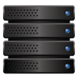


Architecture
Cluster Manager
Build Cloud
ElectricAccelerator Cloud Node
Agent
Agent
emake
Agent
Agent
User-level
Kernel
Electric File System
Cache
Notes:
Key points for the slide:
ElectricAccelerator consists of 3 software components that work together:
ElectricMake: run this where ever you would previously have run GNU Make etc., such as developer machines or nightly build machines. It behaves just like other versions of make, except it doesn’t actually do the detailed work of compiling: it farms that out to machines in the build cluster.
Node software (agent plus EFS): no need to go into a lot of detail about these. Just say that they run jobs on behalf of emake and return results to emake. People haven’t yet seen the dependency management mechanism so you can’t say much about EFS (you can come back to this slide after doing the next slide if you need to explain that). If people ask why there are multiple agents running on a single node, you can tell them that each agent represents one job running at a time; nodes with multiple CPUs can accommodate multiple jobs running simultaneously, so you end up with multiple agents. You can mention that nodes are inexpensive off-the-shelf servers (typical costs: $500-1000 per CPU core). A small cluster would be 10 CPUs; our largest known cluster is more than 300 CPUs at Qualcomm).
The cluster manager consists of an Apache-based Web server plus a database. It serves 2 purposes. First, it manages the nodes on the cluster (when emake starts up, it requests nodes from the cluster manager). The cluster manager allows multiple independent builds to be running at the same time (e.g., two different developers running builds on their machines, plus a production build). When a new build starts up, the cluster manager will take nodes away from pre-existing builds in order to balance the resource allocation; when a build finishes, the cluster manager will reallocate its nodes back to other builds so they can run faster again. You can specify priorities for different builds so that, for example, a critical production build can get a disproportionate share of resources in order to finish faster.

Slide 12
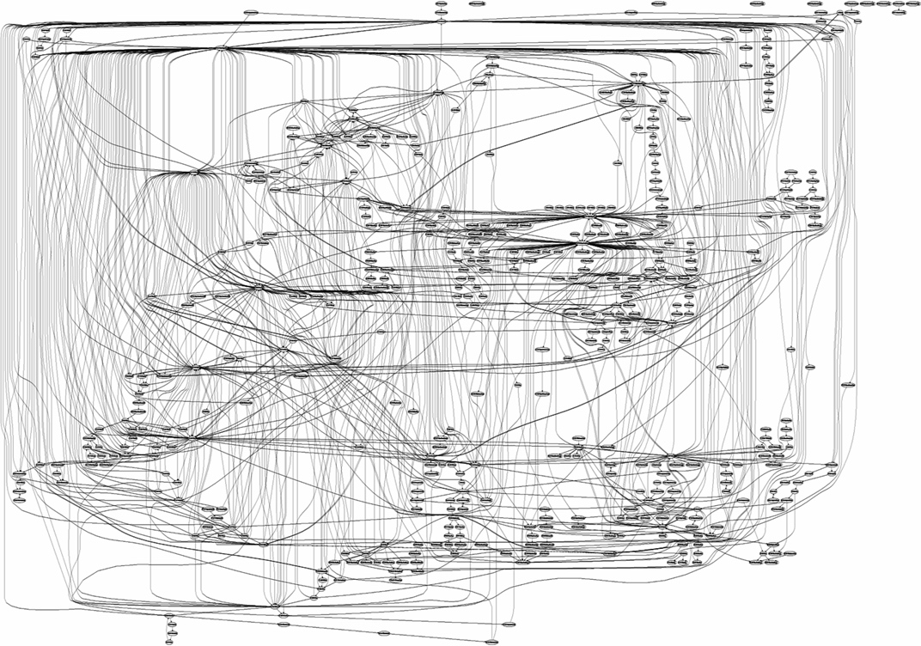
Dependency Management Reality
*Microsoft IIS6 API Dependency Graph

Slide 13
Dependency Detection
Automatically detect and determine dependencies
File system based dependency tracking
Learning system: Saves knowledge of discovered dependencies for future builds
Result
Massively parallel and safe software builds
Guaranteed correct, fast incremental builds
01010
10101
01010
10101
01010
10101
01010
10101
01010
10101
01010
10101
01010
10101
01010
10101
01010
10101
01010
10101
01010
10101
01010
10101
01010
10101
01010
10101
01010
10101
01010
10101
01010
10101
01010
10101
01010
10101
01010
10101
01010
10101
01010
10101
01010
10101
01010
10101

Slide 14
Network Optimization
File caching on nodes cuts 90-95% of network traffic
Just-in-time compression cuts traffic 2.5-3x
P2P file transfers offload 20-25% of outbound traffic
Make Machine
Electric Make
Network bandwidth concentrates at make machine
Network
Node
Agent
File Cache
Node
Agent
File Cache
Node
Agent
File Cache
Node
Agent
File Cache
Electric
File System
Electric
File System
Electric
File System
Electric
File System
Peer-to-peer file transfer
Notes:
File caching on nodes cuts 90-95% of network traffic
Just-in-time compression cuts traffic 2.5-3x:
Match network bandwidth to disk
P2P file transfers offload 20-25% of outbound traffic:
Take advantage of inexpensive bandwidth within switch

Slide 15
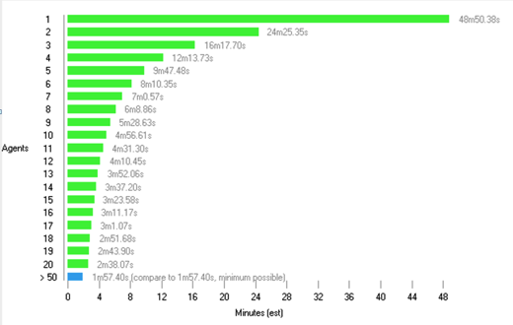
Real world benefits: ElectricInsight
Parallelize and distribute for dramatic acceleration
~20x!
Notes:
ElectricInsight mines the information produced by Electric Make to provide an easy-to-understand, graphical representation of the build structure for performance analysis.
It provides detailed information and reports on each job on each node of the build cluster, helping users identify which jobs are being performed, when, and with what files for at-a-glance diagnostics. Instead of manually pouring over tens of thousands of lines of information in a build output file, error detection and performance tuning that once took hours or days can now be done in seconds.
By observing and tracing sources of serialization or slow-downs, your build can be fine tuned for maximum speed. With ElectricInsight you can quickly pinpoint opportunities for improvement.
Are there any unnecessary serializations?
Are jobs running locally that could be run on the cluster?
With this insight you can get the best possible performance out of your build environment.

Slide 16
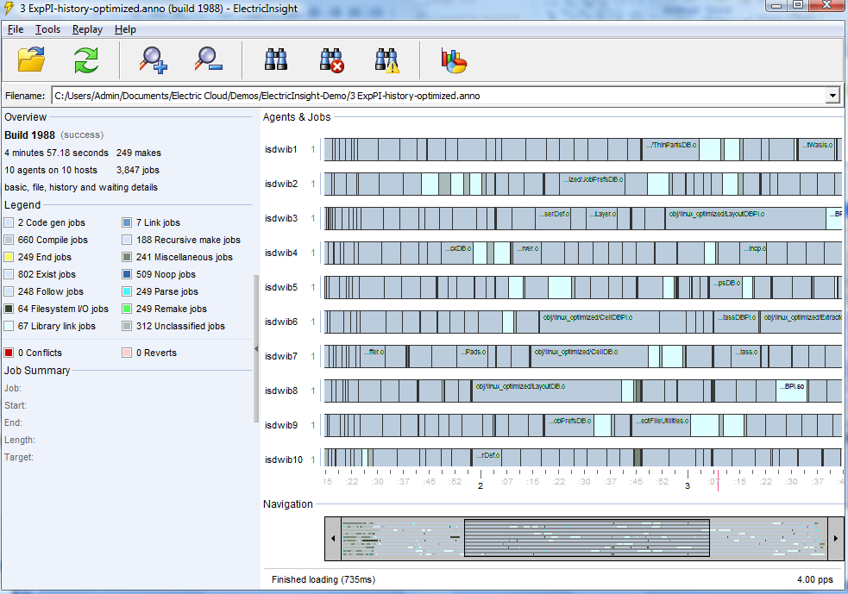
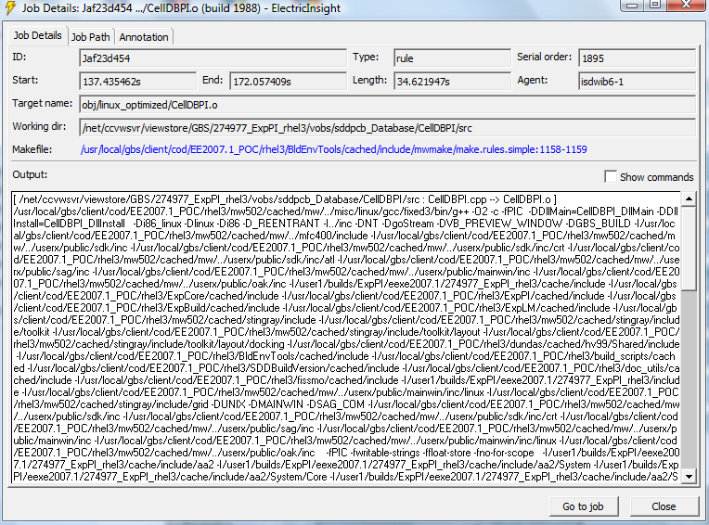
Build Visualization
Overview of build statistics and metadata
Zoom in on specific steps in build for details around input, output, files and duration
At a glance, spot dependencies and optimization opportunities
At-a-glance performance tuning and diagnostics
Notes:
ElectricInsight mines the information produced by Electric Make to provide an easy-to-understand, graphical representation of the build structure for performance analysis.
It provides detailed information and reports on each job on each node of the build cluster, helping users identify which jobs are being performed, when, and with what files for at-a-glance diagnostics. Instead of manually pouring over tens of thousands of lines of information in a build output file, error detection and performance tuning that once took hours or days can now be done in seconds.
By observing and tracing sources of serialization or slow-downs, your build can be fine tuned for maximum speed. With ElectricInsight you can quickly pinpoint opportunities for improvement.
Are there any unnecessary serializations?
Are jobs running locally that could be run on the cluster?
With this insight you can get the best possible performance out of your build environment.

Slide 17
Automated, dynamic dependency management
Massively parallel, safe software builds
Non-intrusive and high performance
Up to 20x acceleration
Boosts engineering productivity
Reduces manual maintenance significantly
Fast, accurate incremental builds
Tool agnostic

Slide 18
Centralized and efficient management of build cloud
Handles heterogeneous, multi-core infrastructure
Sophisticated file caching and compression
Supports thousands of developers
Handles hundreds of concurrent builds
Optimized for build cloud/clusters
Real-time, concurrent workload scheduler
Completely platform and tool agnostic

Slide 19
Analytics to optimize build structure & infrastructure
Actionable, intuitive visualization and reports
Real-time and historic analysis models
Optimize build architecture
Faster build debugging
Optimizes infrastructure utilization
Capacity planning and configuration analytics
Optimize builds based on real knowledge

Slide 20



Transformative Benefits
Issue | Before | After
Speed | The fastest build server is still too slow | 10-20x speedup Agile enabler
Maintenance | Costly labor dedicated to build script maintenance and optimization | Completely automated dependency management Build optimization no longer needed
Scalability | Single servers bogged down Severe bottleneck for growth | Multi-server / multi-platform build environment 1000s of daily builds
Visibility | No understanding of internal build structure Very hard to optimize | Easy, intuitive build visualization enables rapid optimization
Control | No build audit trail Unmanageable burden on IT support | Centralized cluster provides full build history Fault-tolerant, central build farm, single admin interface

Slide 21





Recap
ElectricAccelerator® uniquely enables dramatically accelerated and accurate software builds
Why ElectricAccelerator?
Automated, dynamic build dependency management enables massive parallelization across a build cloud, and guaranteed correct, fast developer incremental builds.
High-performance alternative for most build systems
Centralized and efficient management of build cloud
Analytics to optimize build structure & infrastructure

Slide 22
ElectricAccelerator
Optimized Dependency Management
Reliable Blazing Incremental Builds
Fault-tolerant Workload Distribution
Enterprise-scale Centralized Build Cloud
Rich Analytics and Monitoring

Slide 23
ElectricFlow/Commander

Slide 24

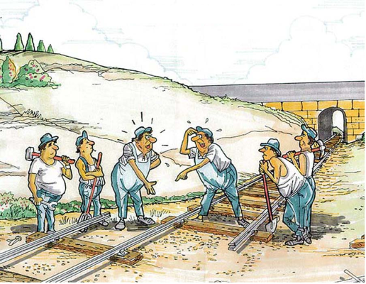
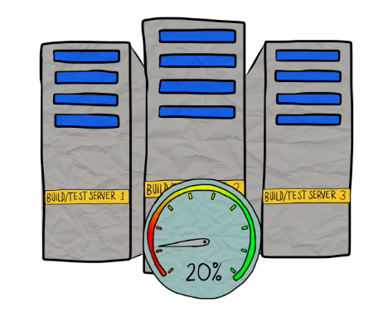

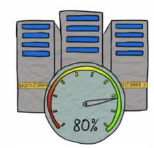
Software Delivery Challenges
Islands of Automation
Lots of disparate tools, little orchestration
No standards, no reuse
No end to end visibility
Poor resource utilization

Slide 25
What’s needed for efficient software delivery
Test automation
Build automation
Deployment automation
Delivery Pipeline Orchestration
Visibility & traceability
Artifact Repository
Infra Provision & Configure
Tool Integrations
Notes:
Transition to selling.
What is needed is a solution that provides integrated automation from Dev to Ops – automates all the process, all the bits, and provides full transparency into the process.
The solution needs to integrate to the Dev tools – because Dev owns the apps, has knowledge of the apps and its changes
The solution also needs to integrate to Ops, because Ops owns the infrastructure.
Lastly, the two teams have different cultures – therefore having a common toolset ensure that the same processes are applied as the process moves from dev -> Ops.

Slide 26

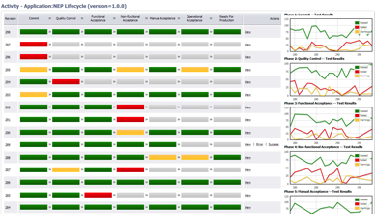
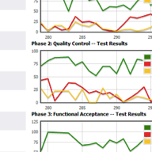
ElectricFlow Continuous Delivery Automation
Family of end-to-end CD apps delivers visibility, governance, and consistency from commit to deploy
High availability CD at scale means supporting 1000’s of global developers without losing jobs in flight
Mobile friendly user interface
Pooling of resources means massive throughput and optimized infrastructure

Slide 27
Natively integrated end to end Continuous Delivery
Apps
Automation Platform
(commander)
ElectricFlow
Pipeline & Release Management
Build
Test
Deploy
Shared models and practices
Builds/Tests
Applications
Components
Environments
Pipelines/Releases
Shared visibility and flexible automation
Procedures
Workflows
Projects
Resources
Jobs
Reports
Artifacts
Enterprise-grade
High Availability
Horizontal Scalability
Traceability
Security
Multi-platform

Slide 28
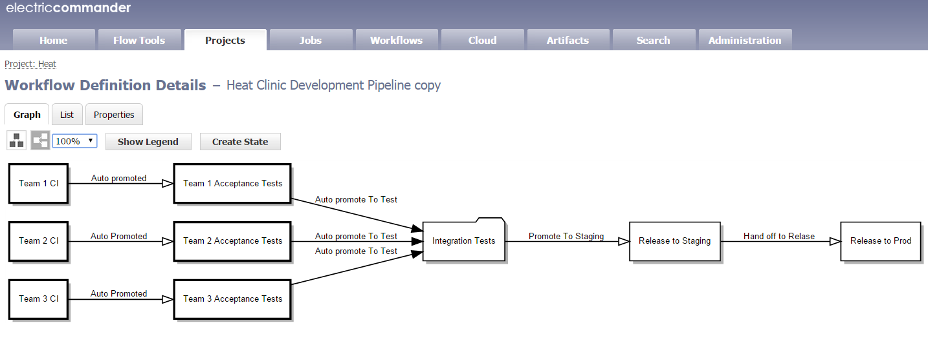
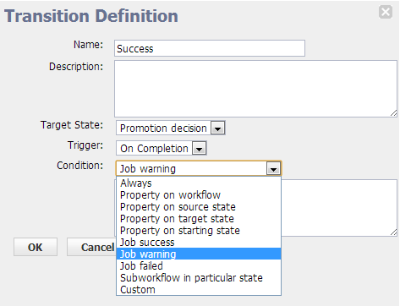
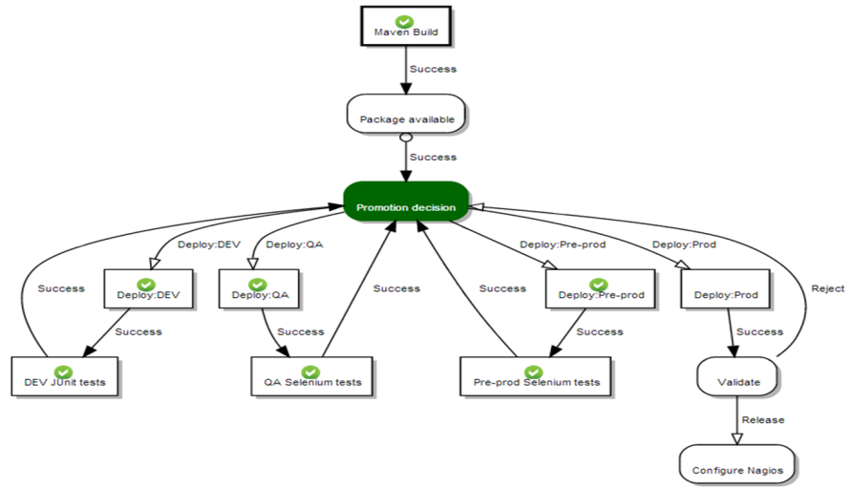
Delivery Pipeline Orchestration
Powerful transition definition
Define conditional automated transitions or manual transitions
Release/CD process workflow
Capture deploy process and requirements
Consistent and repeatable
Model your Pipelines
Complete control over your process
Define Stages and Gates
Define hierarchical pipelines
Define sub-workflows

Slide 29

Software Delivery Pipelines

Slide 30
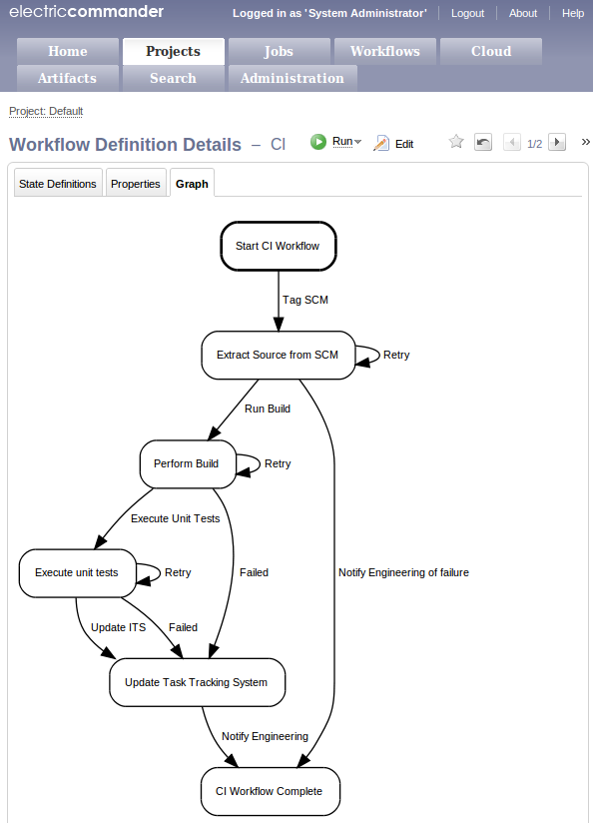
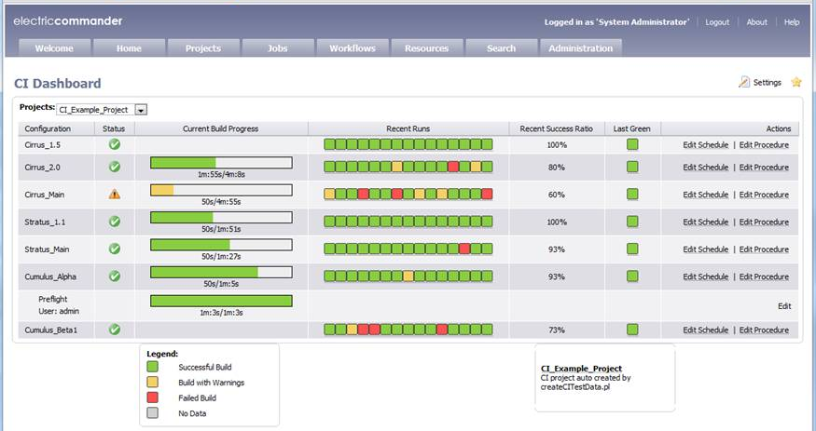
Build Automation/CI
Pre-Flight builds
Gated check-ins to ensure green CI builds
Flexible Build Processes
integrated to SCM, build, unit test systems
Comprehensive Visibility
CI Dashboard and reporting

Slide 31
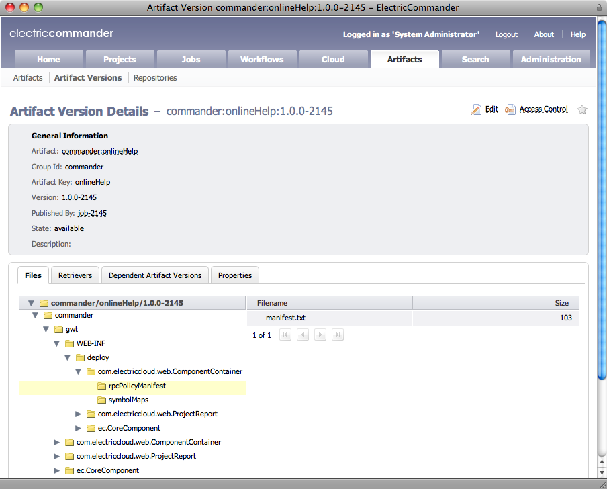

Artifact Repository
Ensure the right artifact is used each time a process is run, at every stage of the lifecycle
Repository
Share
Consume
Consume
Dev
QA
Prod

Slide 32
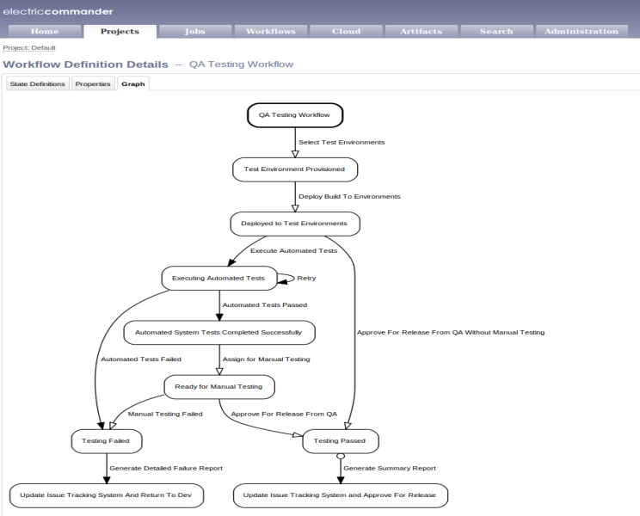
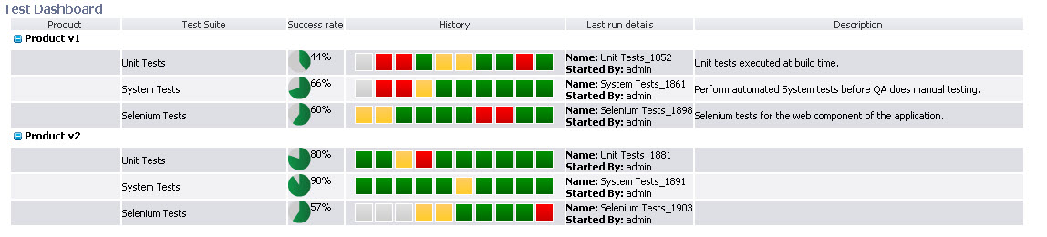
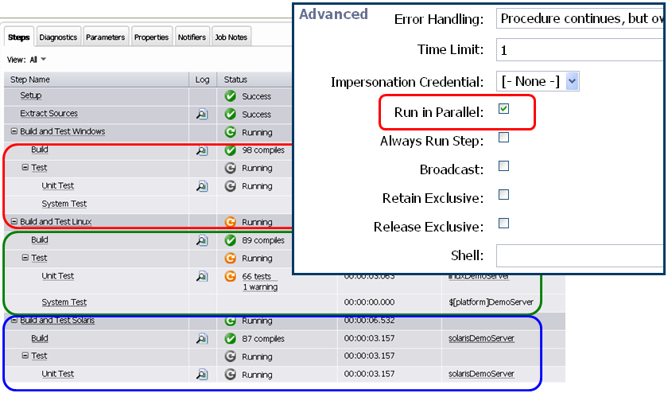
Test Automation
Test workflow
Deploy to test environment
Run tests on tool of your choice
Aggregate test results
Update test status
Test Dashboard
Auto Run Tests in Parallel
With a simple click in process definition
Auto manage differing required resources
Act on consolidated results data

Slide 33
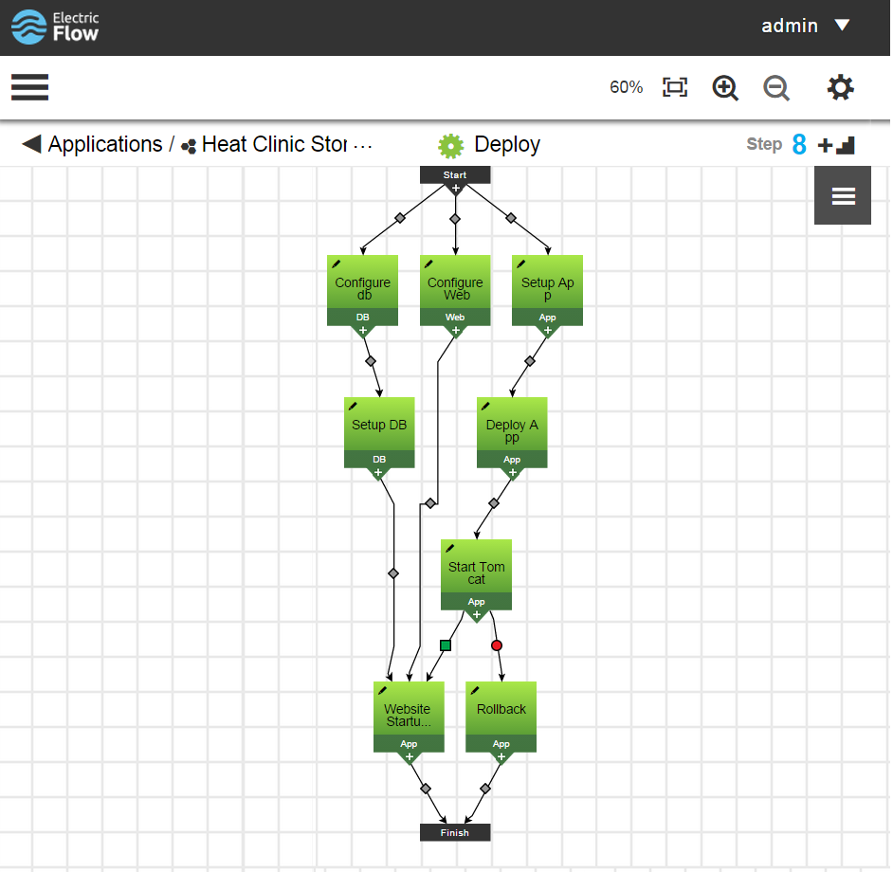
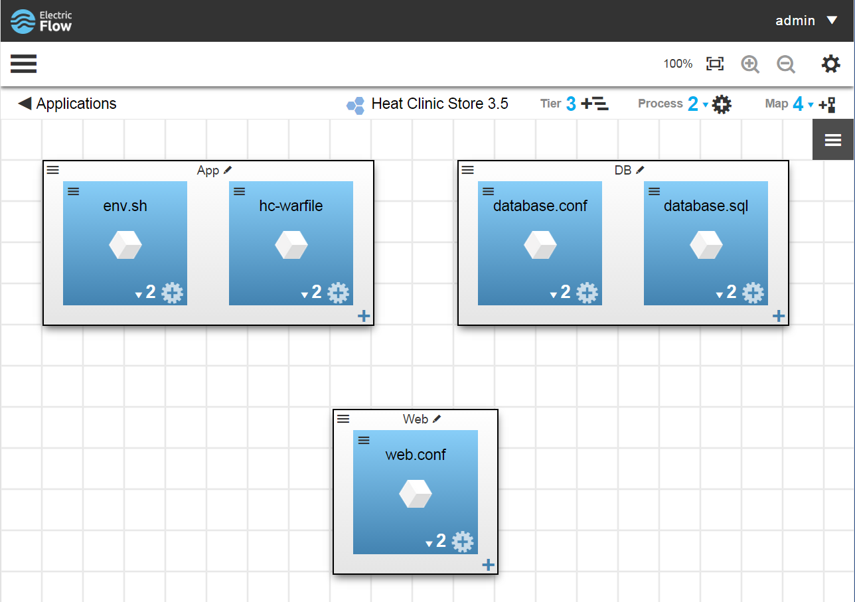
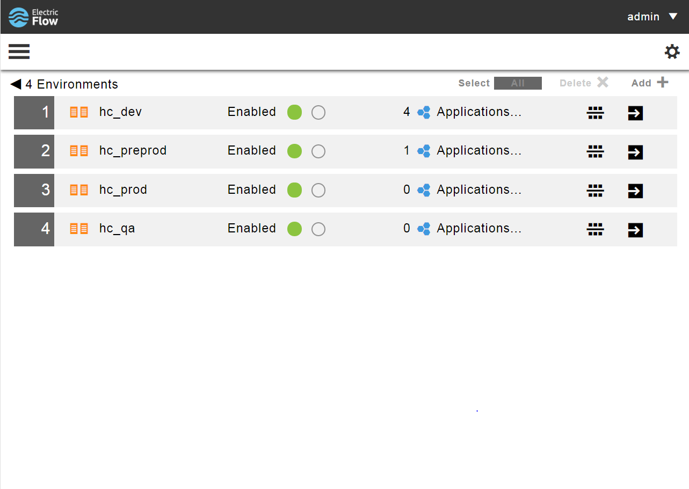
Model-Driven Deployments
Application Model
Application Process
Environment Model

Slide 34
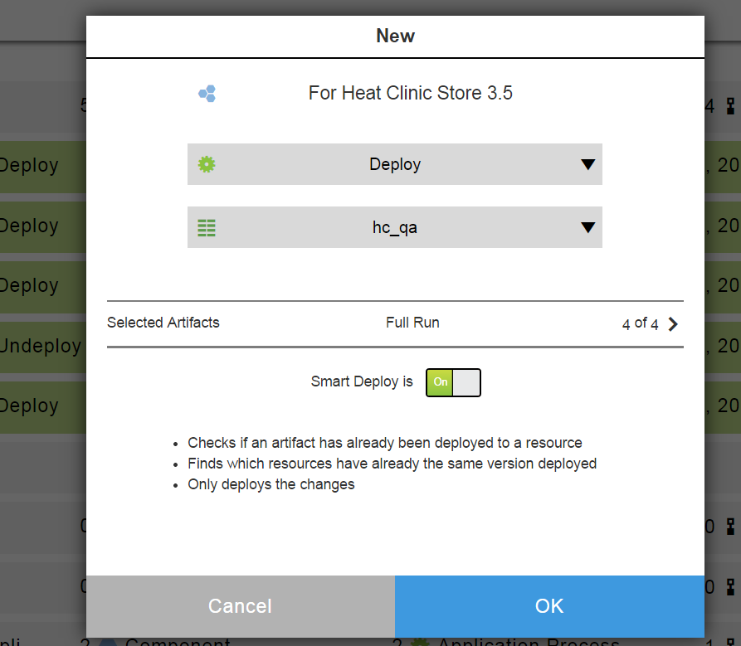
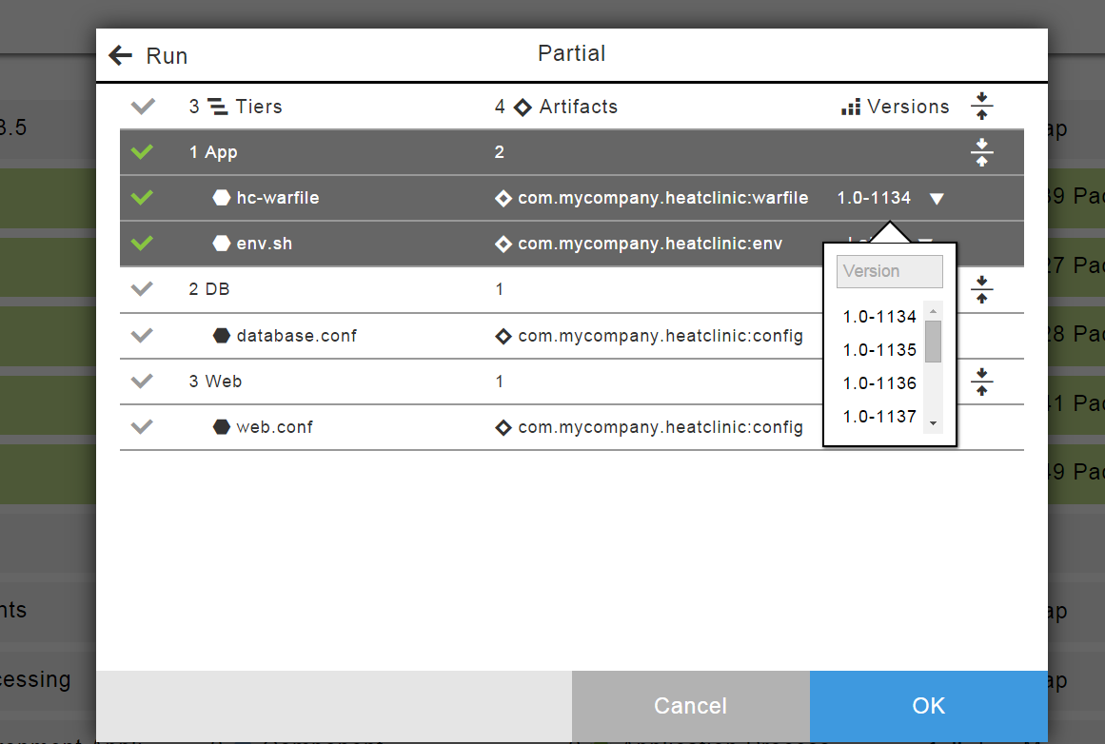
Smart Deployments with manual override
Lowered risk and faster deployments
Automatically detect delta with what is already on the environment
Deploy only what is needed
Complete control over what is deployed
Manually override exact versions to be deployed if needed
Select/unselect components to deploy

Slide 35
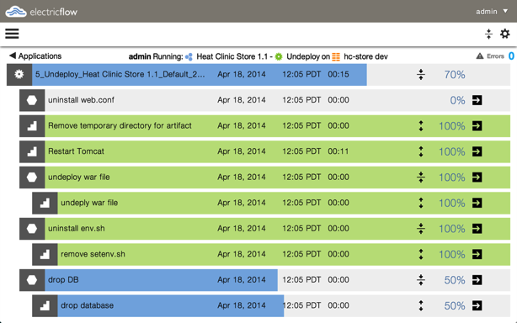
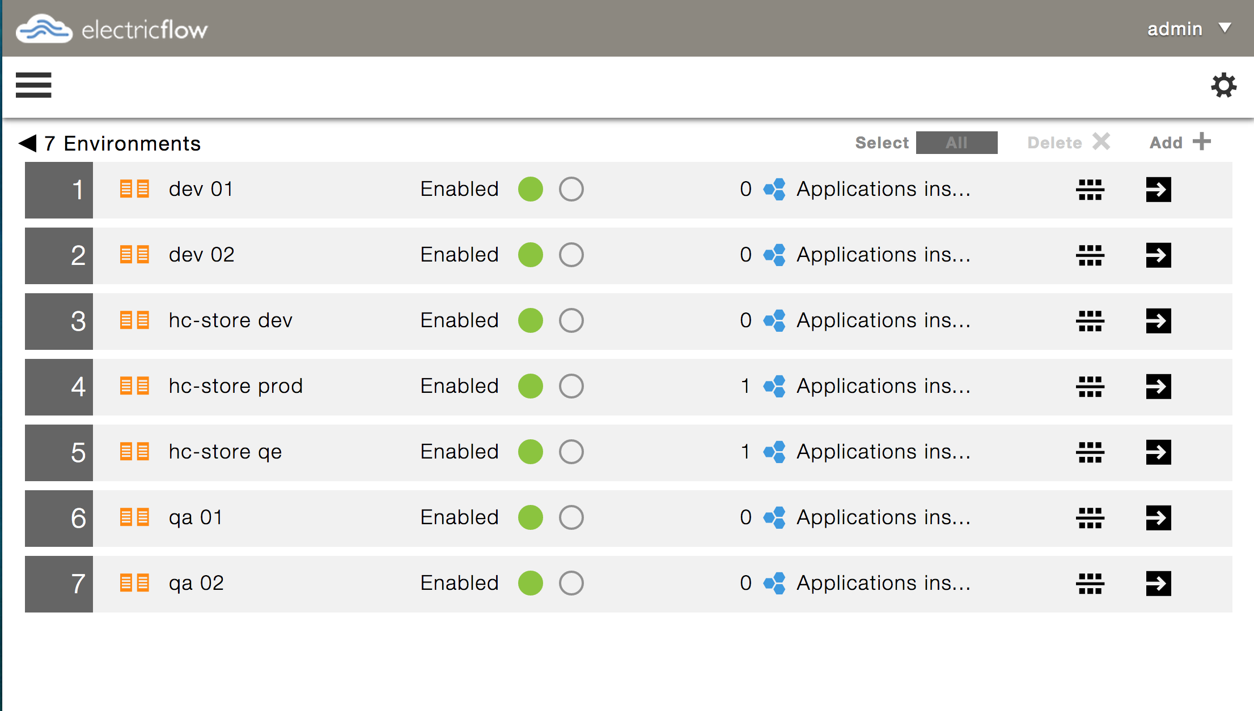
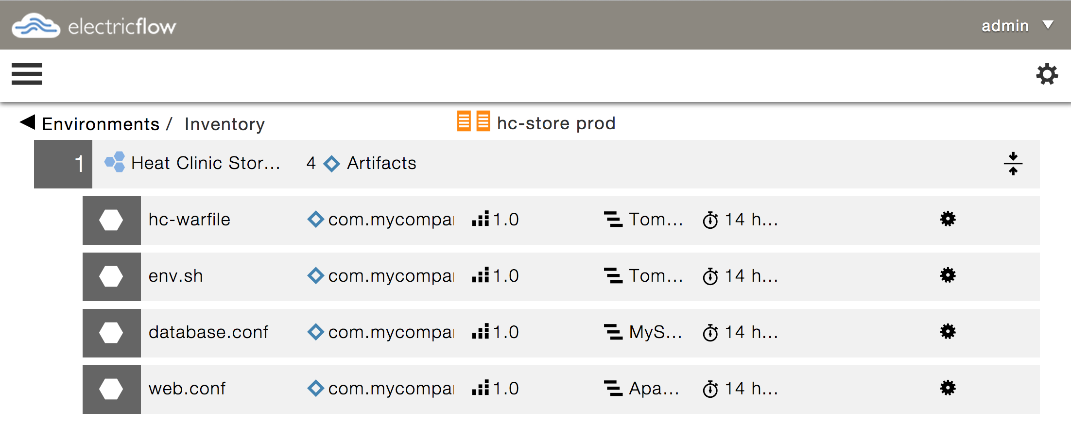
Complete Visibility – During and After deployments
Execute deployments
Push button deploy
Real time view of deployments
What is deployed where
Track applications in environments
Track artifacts on each server

Slide 36







Sophisticated Resource Management Resource management with process context improves resource utilization
Automatic
Provisioning
+
Automatic
Configure & Use
+
Automatic
Tear Down
Notes:
Our advanced resource management enables efficient use of the physcial/virtual and dynamic cloud resources by managing the resources with process context
Securely control machines, VMs, cloud, devices
Transparently select by dynamic tags
We offer out of the box integration with Vmware, AWS EC2, Eucalyptus etc.
We offer integrations to configuration management tools such as with Opscode Chef and PuppetLabs Puppet.
By setting up these resources automatically, we can execute tasks in parallel.
By being close to the development process, we know when we can let go of resources, and when we need to keep them tied up.
For example, if a test fails, we might want to keep the resources so that development can troubleshoot it. But if there is a success,
we can record the details and then return the resource to the resource pool.

Slide 37
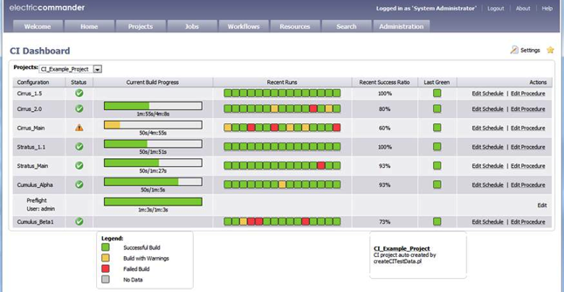
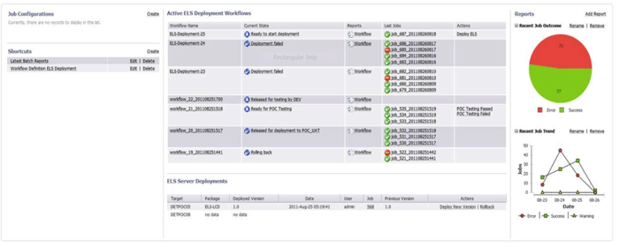
Visibility and Traceability
Build artifact indexing and tracking
Real-time visibility into project health
and activity

Slide 38

When the going gets tough….
High Volumes?
High Complexity?
Lots of resources?
Lots of teams?
Lots of tools?
BRING IT ON

Slide 39

Flexibility
Advanced Property Management
Dynamic code generation
Advanced Workflow
Post processor
Extensibility
RESTful API
SDK
Customizable Interface

Slide 40
Enterprise Scale Platform
Site 1
Agent
Site 2
Agent
Agent
Agent
Database
Agent
Workspace
Commander Server
HA/
HS
Browser
Commander Server
Commander Server
Web Server
Repository 2
WAN
Workspace
Repository 1
Browser
Web Server
Agent
Agent
Agent
Agent
Agent
Agent
Site 3
Agent
Agent
Agent
Agent
Workspace
WAN
Web Server
Repository 3
Site 1 (web only)
Browser
Browser

Slide 41





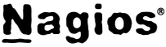


















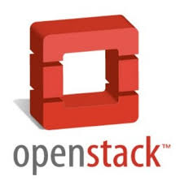


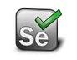

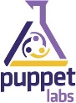




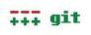







Integrations to 100’s of Tools
100’s of out of the box plug-in integrations
Published SDK
Market driven
plug-in factory

Slide 42

Benefits
Reduced delays & faster TTM
Reduced errors & higher quality
Improved Collaboration
Reduced Costs
Improved utilization
Notes:
And by automating the process and the resources, we help our customers
Accelerate their process and reduce TTM
Improve the quality of the deployed/released application
Improve the resource utilization
Improve the collaboration between the Dev and the Ops organization

Slide 43



Ship.io: Hosted CD for mobile apps
Automatic build process configuration.
Secure, hands-free compilation and code signing.
Tight GitHub integration and support for any GIT SCM.
Build
Simulator and hardware testing services.
Support for functional and unit testing frameworks.
Video capture and playback from testing sessions.
Test
One-click OTA release dashboard.
TestFlight and HockeyApp OTA services.
Fully custom OTA implementation.
Deploy

Slide 44
Why Electric Cloud?
Only unified Continuous Delivery platform spanning the end-to-end build, test, and deployment lifecycle
Proven enterprise scale supporting up to 10’s of thousands of globally distributed developers and servers
Patented technology delivering unmatched acceleration and automation that dramatically shrinks cycle times
Transformative results for hundreds of customers, including segment leaders in networking, mobile devices, automotive, financial services, and semiconductors

Slide 45


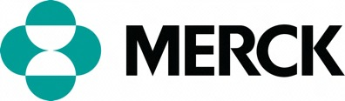


Transformative Benefits
10 min FASTER DEVELOP TO DEPLOY 90 days
99% improvement
TIME
0 errors LESS ERRORS per cycle 10 errors
90+% improvement
ERRORS
15 min FASTER DEPLOYMENTS 90+ min
80+% improvement
TIME
6 hours FASTER DEVELOP TO DEPLOY 24 hours
75% improvement
TIME
minutes FASTER AUDITABILITY who, what, when, how 20 days
90% improvement
TIME

Slide 46












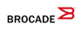











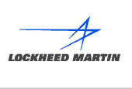


Segment leaders love Electric Cloud
Networking
Mobile Devices
Semiconductor
ISV, Internet & Entertainment
Financial
Services
Powering Continuous Delivery
Automotive
Medical Devices
Aerospace / Defense
Heavy Industry
Other Systems
Notes:
Here’s a sampling of our customers
MS has deployed a B-T cloud on our solution
Vmware uses us for test mgmt in the Vcloud director group
RIM has built a cloud to manage the B-T process for all their phone software

Slide 47

Thank you
Q&A
Networking
Mobile Devices
Semiconductor
ISV, Internet & Entertainment
Financial
Services
Automotive
Medical Devices
Aerospace / Defense
Heavy Industry
Other Systems
Notes:
Here’s a sampling of our customers
MS has deployed a B-T cloud on our solution
Vmware uses us for test mgmt in the Vcloud director group
RIM has built a cloud to manage the B-T process for all their phone software

